Slide 1






ENERGY USAGE IN KENTUCKY
Anandwi Ghurran Muhajjalin Arreto
Teknik Komputer 2017
1706985911

Slide 2





DATA
ANALYSIS
TABLE OF CONTENTS
Method
CONCLUSION
Electricity consumption in the state of Kentucky
Graph and correlation with other data
Prophet from Facebook

Slide 3
DATA
Electricity consumption in the state of Kentucky

Slide 4

KENTUCKY STATE
Kentucky is located in the eastern United States

Slide 5
ELECTRICITY USAGE
The data that would be used contains:
Hourly timestamp
Electricity usage in Mega Watt (MW)
This data was obtained from PJM (Pennsylvania, Jersey, Maryland Power Pool).
URL:
https://www.kaggle.com/robikscube/hourly-energy-consumption#EKPC_hourly.csv

Slide 6
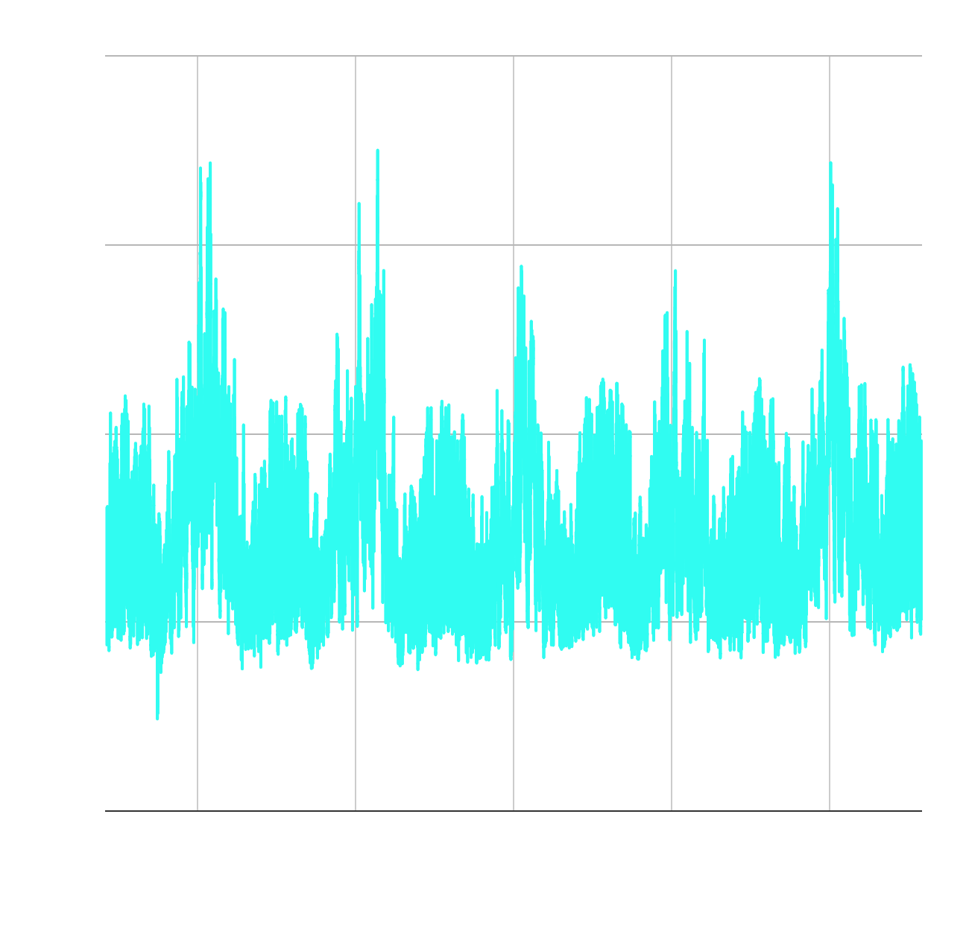
ENERGY USAGE (MW)
ELECTRICITY USAGE
Data collected from 01/06/2013 1:00:00 to 03/08/2018 00:00:00

Slide 7
02
Method
Prophet from Facebook

Slide 8
Prophet Method
Prophet is an open source software used to forecast time series data that released by Facebook’s Core Data Science team. The forecasting is based on additive model and the trend can be fitted in yearly, monthly, weekly, and daily.
Prophet using time series model that contain three main components which are trend, seasonality, and holidays. These component combined into an equation:
y(t) = g(t) + s(t) + h(t) + ε_{t}
g(t) = piecewise linear or logistic growth curve for modelling non-periodic changes in time series
s(t) = periodic changes (e.g. weekly/yearly seasonality)
h(t) = effects of holidays (user provided) with irregular schedules
ε_{t} = error term accounts for any unusual changes not accommodated by the model

Slide 9
Prophet Method
Prophet best used for data that have any of the following characteristics:
Hourly, daily, or weekly observations with at least a few months (preferably a year) of history.
Important holidays that occur at irregular intervals that are known in advance.
Historical trend changes
Trends that are non-linear growth curves
The electrical usage data can be used with Prophet because it satisfy the characteristic from the above.
Prophet tutorial can be seen in:
https://facebook.github.io/prophet/

Slide 10
03
ANALYSIS
Graph and correlation with other data

Slide 11
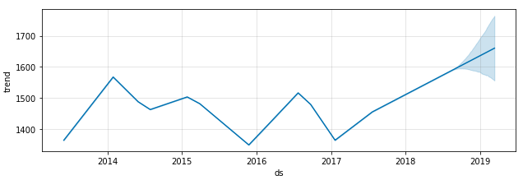
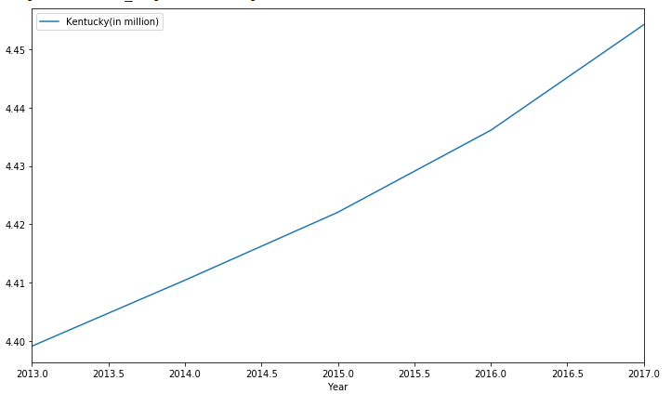
TREND LINE
Energy use has decreased until 2016, but starting from 2017 energy use continues to increase.
This trend can be caused by population growth in the state show in the graph.

Slide 12
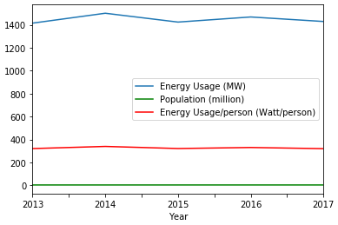
ENERGY USAGE IN 2013 - 2017
Year | Energy Usage (MW) | Population (million) | Energy Usage/ person (Watt/ person)
2013 | 1414.277172 | 4.399121 | 321.490855
2014 | 1500.405479 | 4.410415 | 340.195986
2015 | 1423.415639 | 4.422057 | 321.889935
2016 | 1467.900501 | 4.436113 | 330.897906
2017 | 1428.601370 | 4.454189 | 320.732095
With average each year, can known how many energy each person using

Slide 13

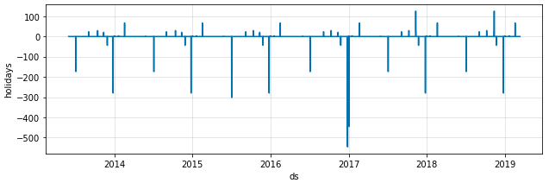
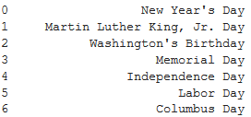
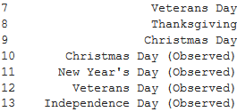
HOLIDAY EFFECT

Slide 14
HOLIDAY EFFECT
There are huge decrease in energy consumption during Christmas holiday and Memorial Day. Most of it because during that holiday most of worker in Kentucky took a day off so the energy consumption in decreasing.
However New Year, Washington’s Birthday, Independence Day, Labor Day, Columbus Day, and Veteran Day will increase the energy consumption because there are parade at that holiday.

Slide 15
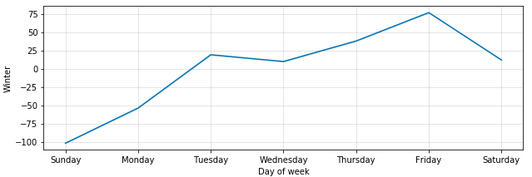
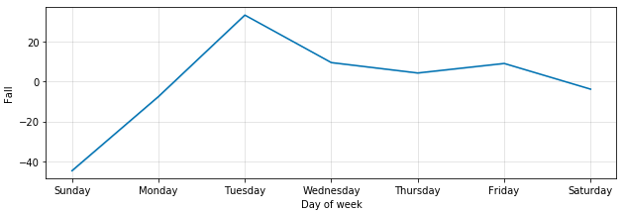
SEASONAL
FALL WINTER

Slide 16
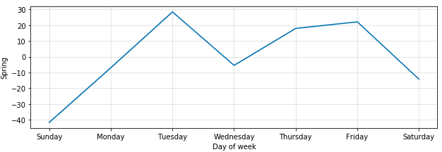
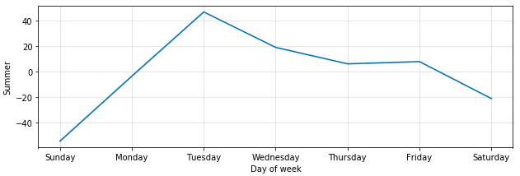
SEASONAL
SUMMER SPRING

Slide 17
SEASONAL
The energy consumption in Kentucky state affected by the season of the state. There are four season that are winter, fall, spring, and summer. Each season takes event at:
Winter : December to February
Fall : September to November
Spring : March to May
Summer : June to August
The highest use of energy is in winter and peaking at Friday because the daytime in winter is the shortest than any other season. That causes the use of energy for lamps to increase rapidly. For addition people use heater too in winter to warm their body.

Slide 18
SEASONAL
The lowest average energy consumption is at Fall. It can be caused by the temperature at Fall isn’t too hot or too cold. Therefore the use of air conditioner and heater is decreasing.
Summer and spring almost has the same graph meaning that the energy consumption at that seasons don’t change too much. Also the temperature at summer and spring is high thus the use of air conditioner increase.
In almost every season, Tuesday has the most energy consumption indicating that Tuesday can be the day that most of Kentucky’s citizen work or study. After that it is gradually decreasing until Sunday where everyone is at vacation and makes the energy consumption the lowest.

Slide 19
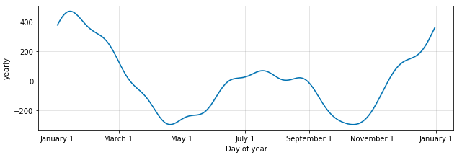
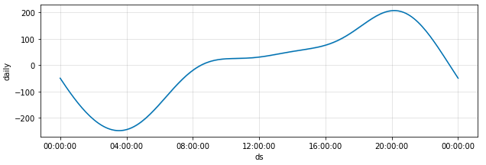
YEARLY AND DAILY
DAILY YEARLY

Slide 20
YEARLY AND DAILY
In a year, the electricity usage has the same pattern that is always peaking at end of the year and beginning of the year. That caused by the season as explained before.
In daily use, the peak of electricity use is at 20:00 and has lowest use at 4:00. With this data, it can be assumed that citizen of Kentucky do their daily activity such as working, playing, studying, etc. at around 4:00 to 20:00. They approximately have 6 hours of sleep according to the graph.

Slide 21
04
CONCLUSION

Slide 22
DAY
HOLIDAY
ELECTRICITY USAGE FACTOR
SEASON
Energy consumption will be affected by week day and weekend because many job take place in week day
Holidays can affect energy consumption because there is less work and more family time for holidays such as the Christmas holidays
POPULATION
There are four season in Kentucky that can affect energy consumption
Human population can affect the energy use as more human use electricity device

Slide 23

WORK HOUR
KENTUCKY’s CITIZEN
WORK DAY
Most of the citizen has work hour starting from 4:00 to 20:00
Most of the citizen works from Monday to Friday and vacation on weekend

Slide 24



THANKS!
https://github.com/anandwigma/Forecasting-Energy-Consumption-Using-Prophet
@agmarreto
https://www.instagram.com/p/B6IxFO3nw2q/?utm_source=ig_web_copy_link

